Slide 1

ERsed Respiration data- 2022
48 observations (sites) in total
Remove positive ERsed values (3 sites with ER_sed >0)
# Missing values: Hyporheic exchange flux (2), Chlorophyll_A(2),TSS(2),
Target variable in the MLR analysis: ERsed_square
Regression variables:
Depth, Velocity, Slope , Discharge
HOBO_Temp (water temperature)
Hyporheic exchange flux, Chlorophyll_A
totdasqkm (total drainage area),
D50_m, aridity, TSS, Stream order
PctMxFst2019Ws (%forest) , PctCrop2019Ws (%crop), PctShrb2019Ws(%Shrb)
GPP
Log transform for Slope, D50_m, totdasqkm, "Discharge", 'Average_Depth' and TSS

Slide 2
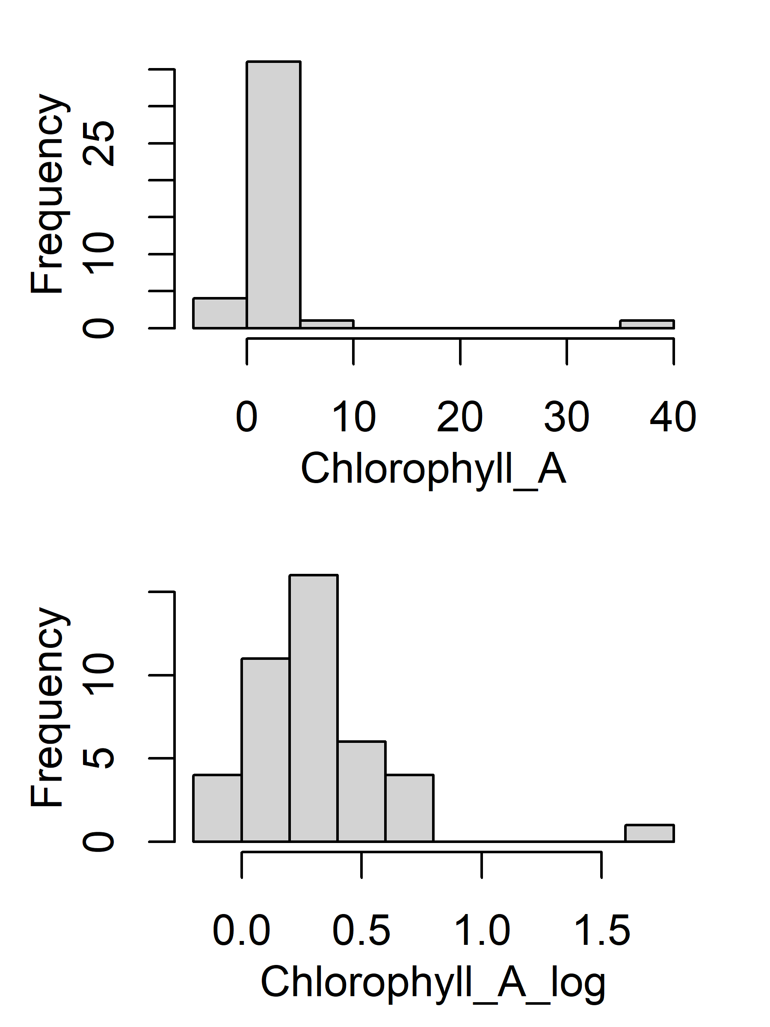
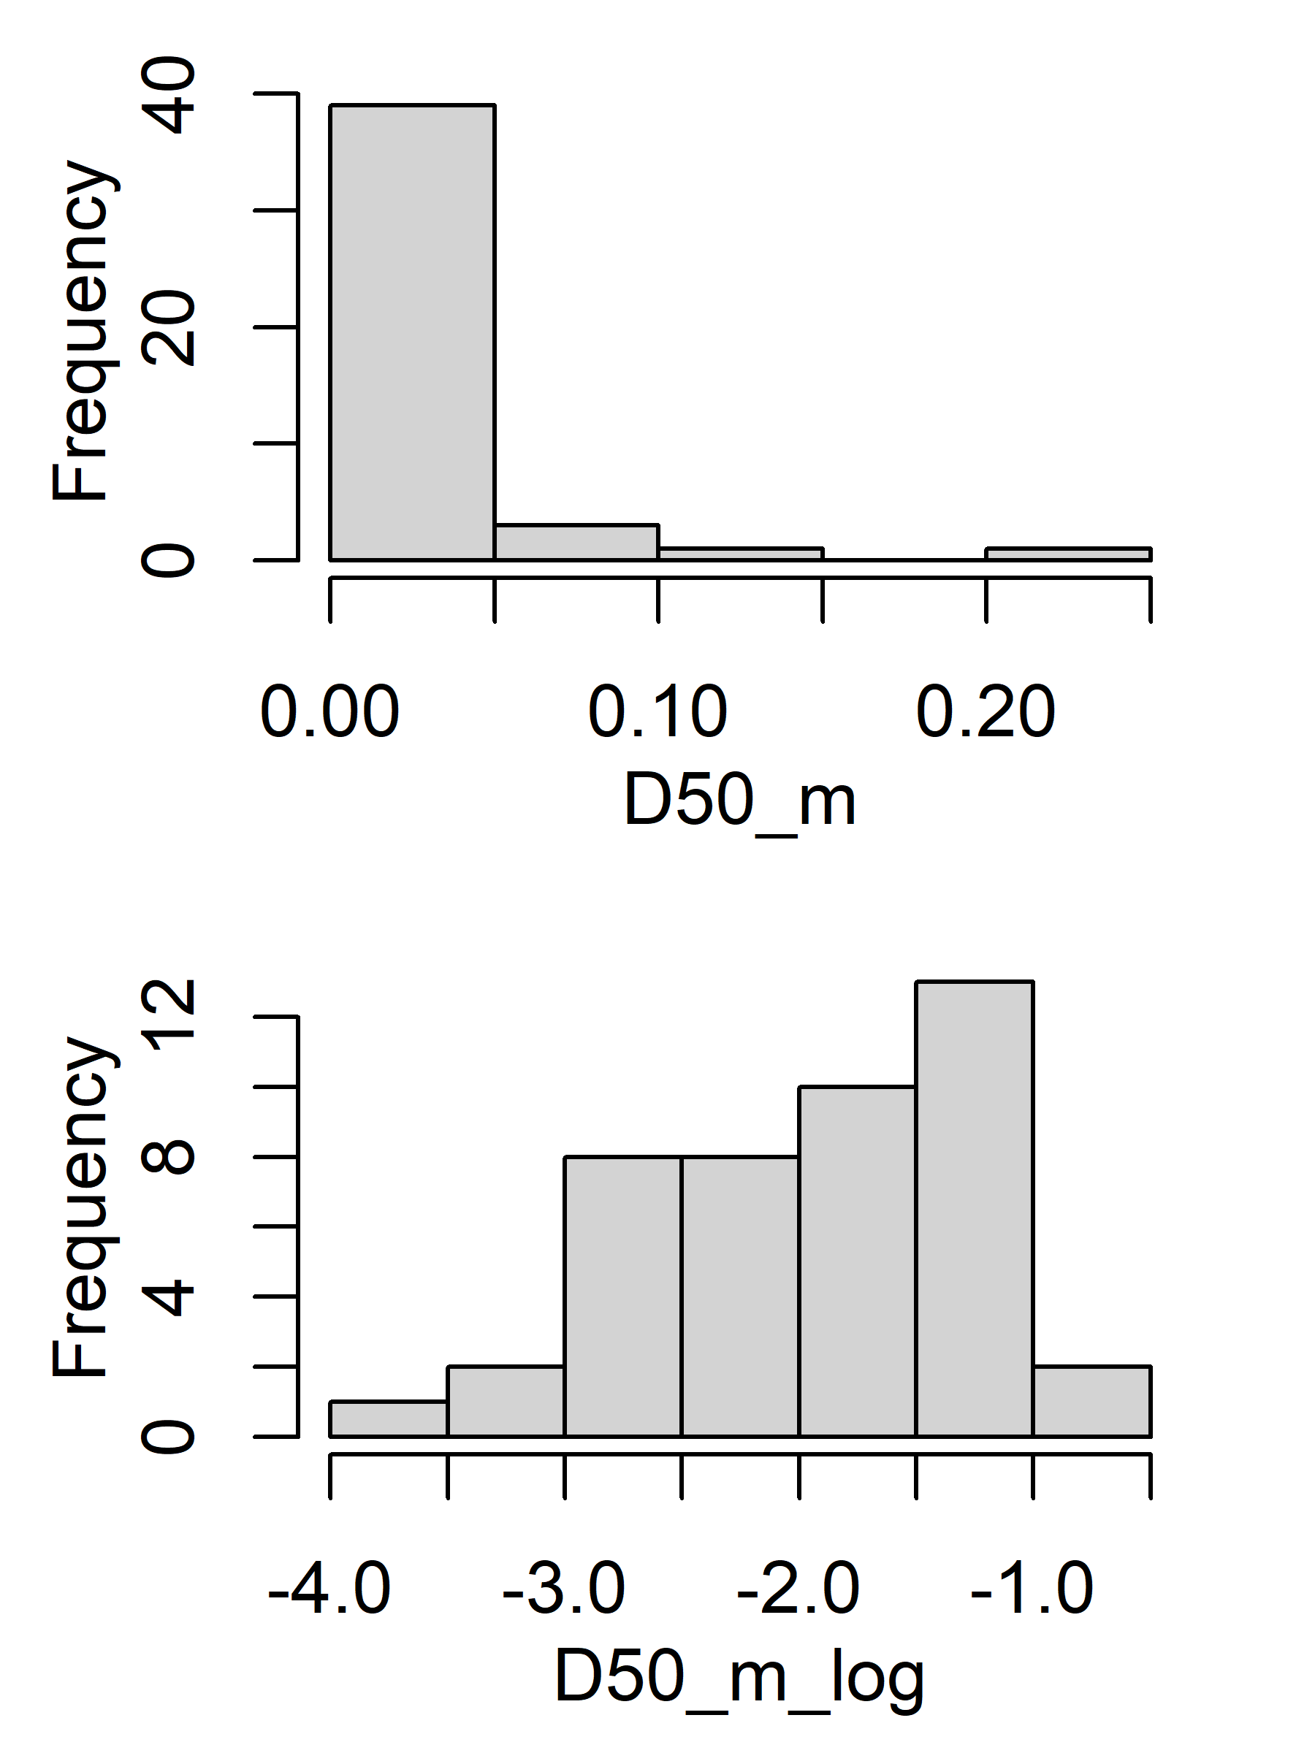
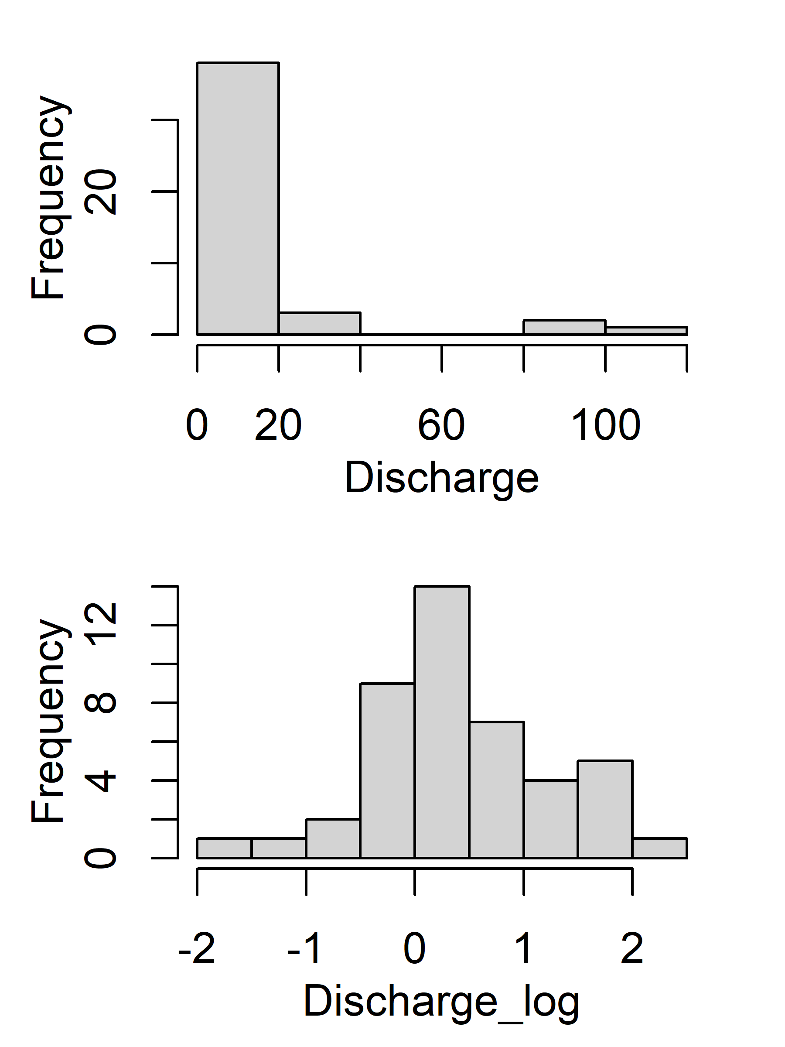
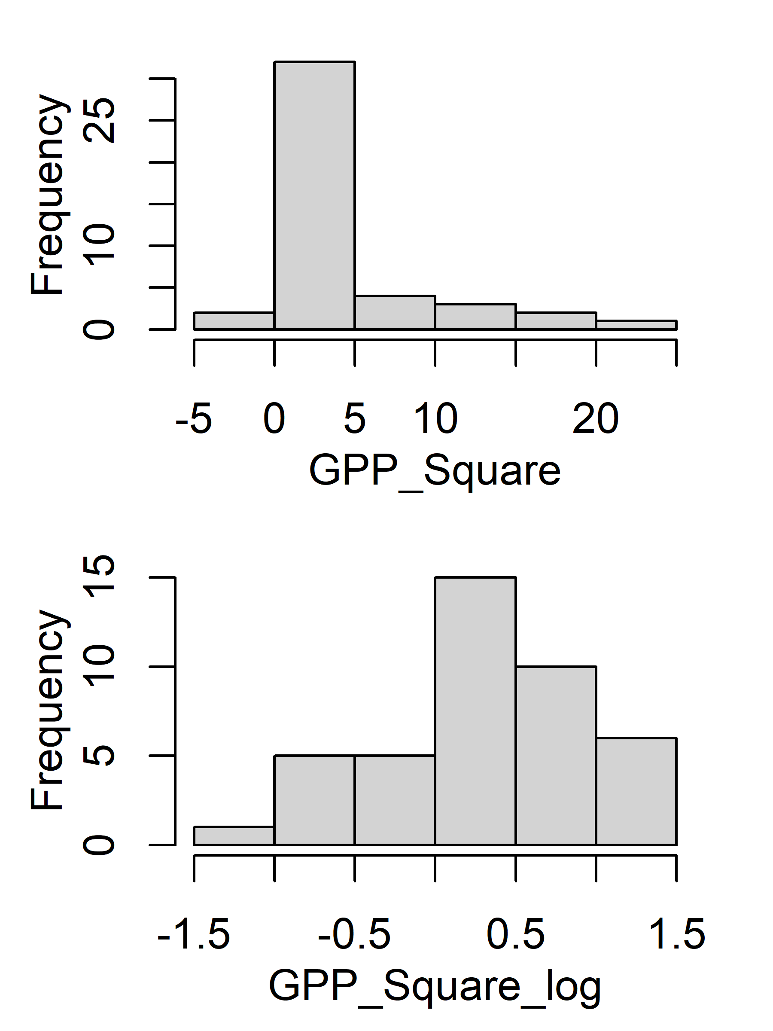
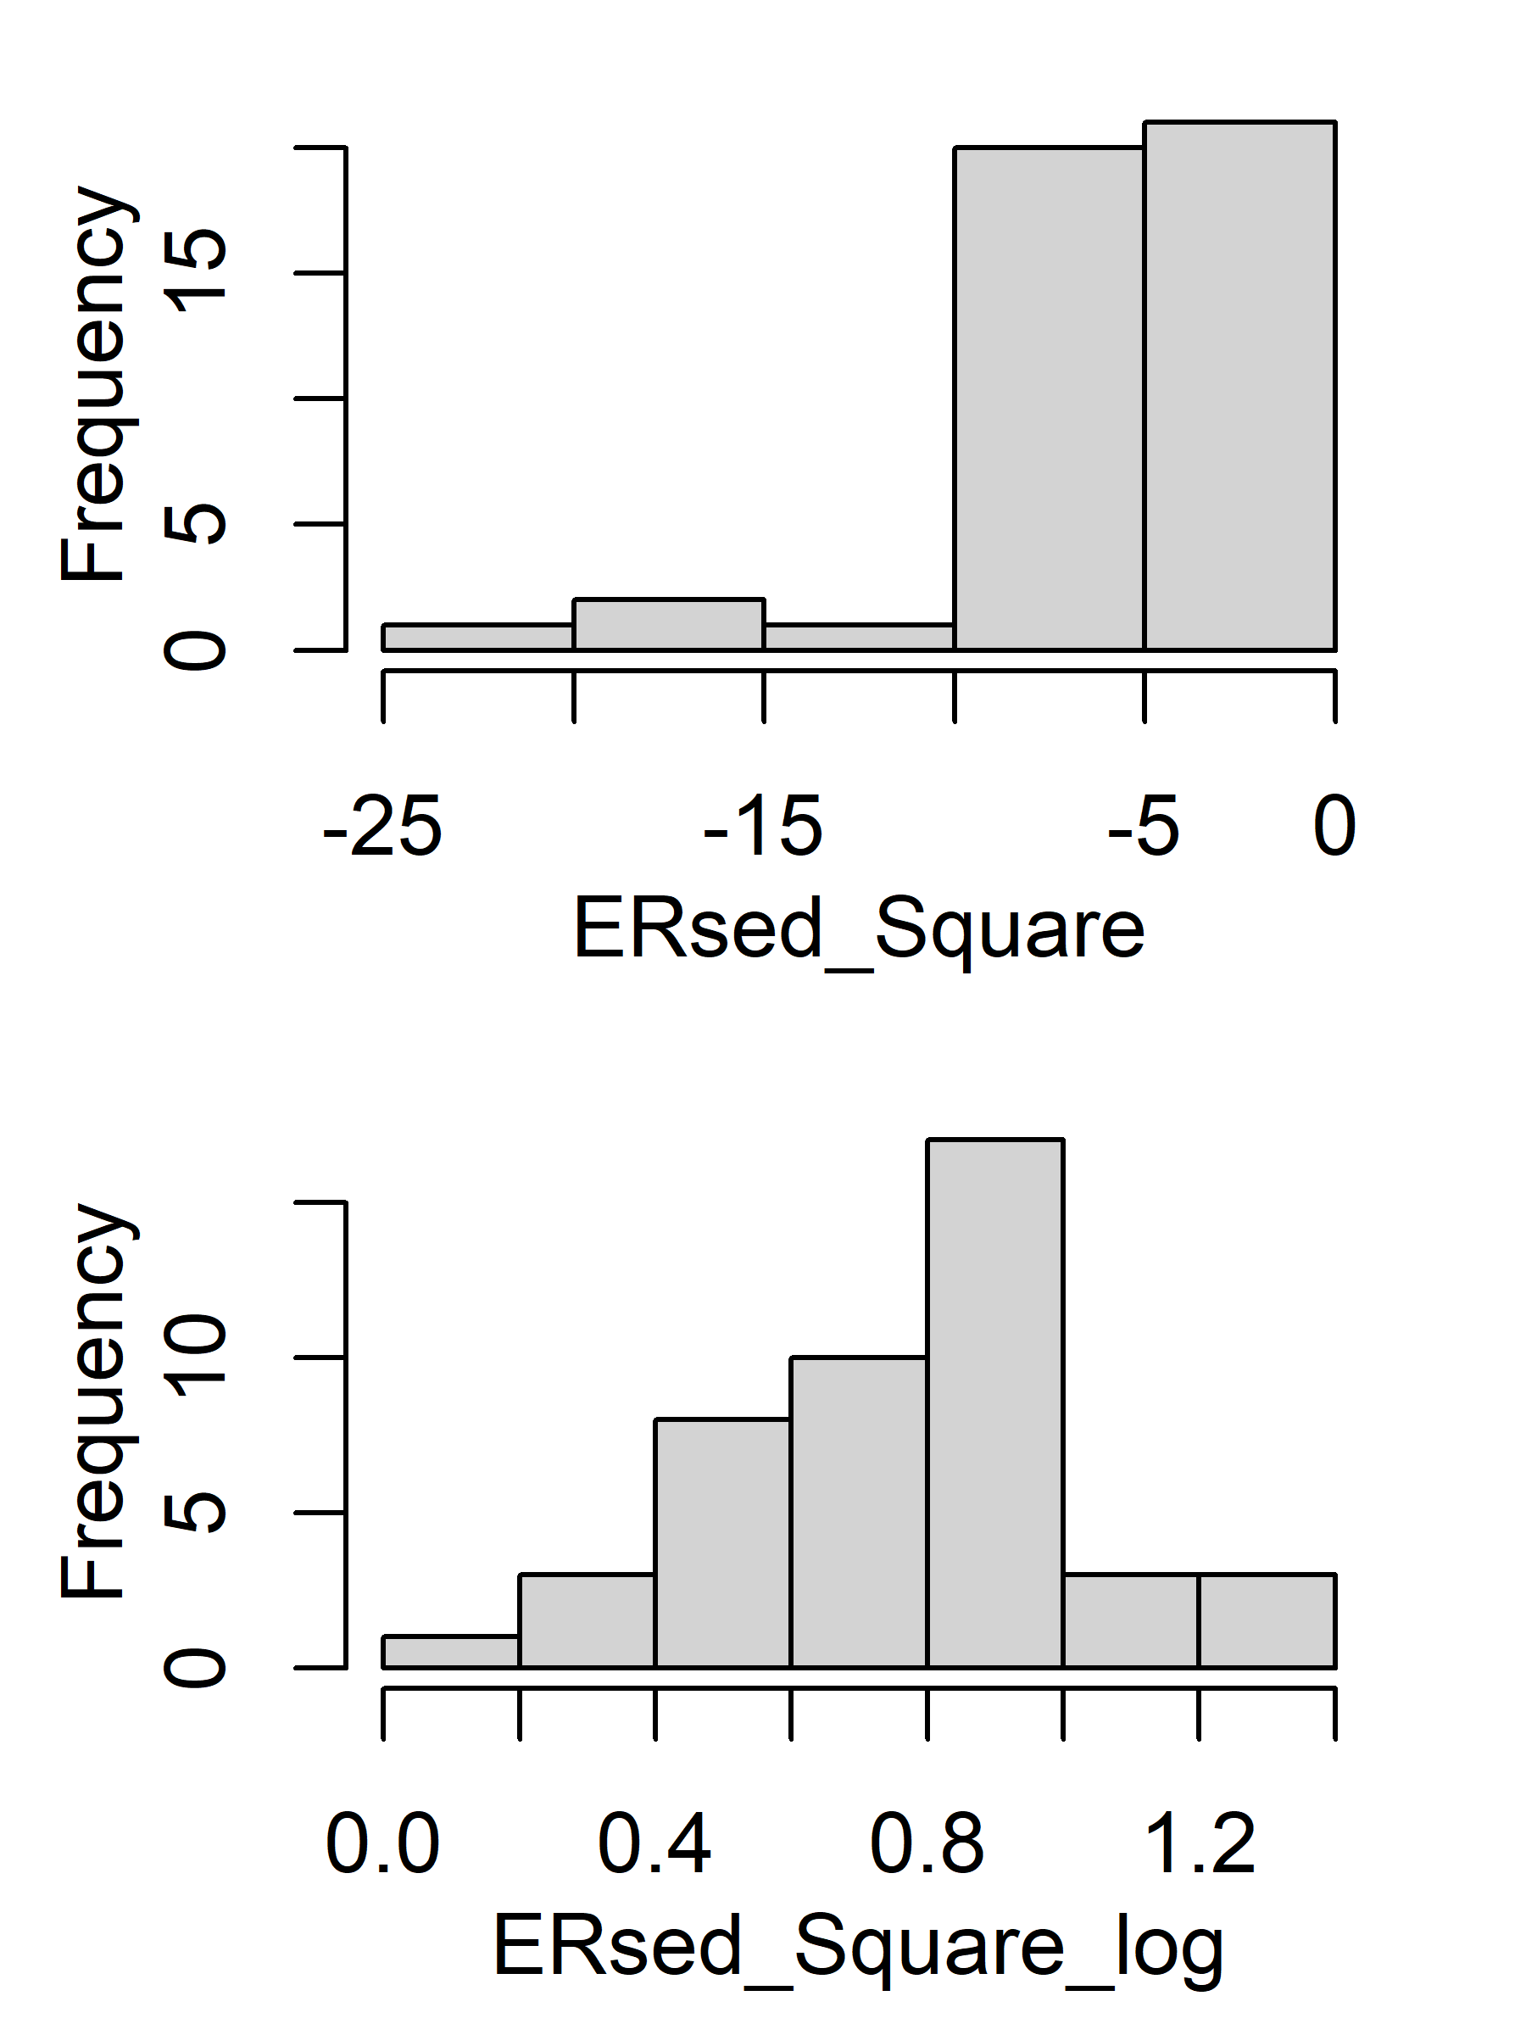
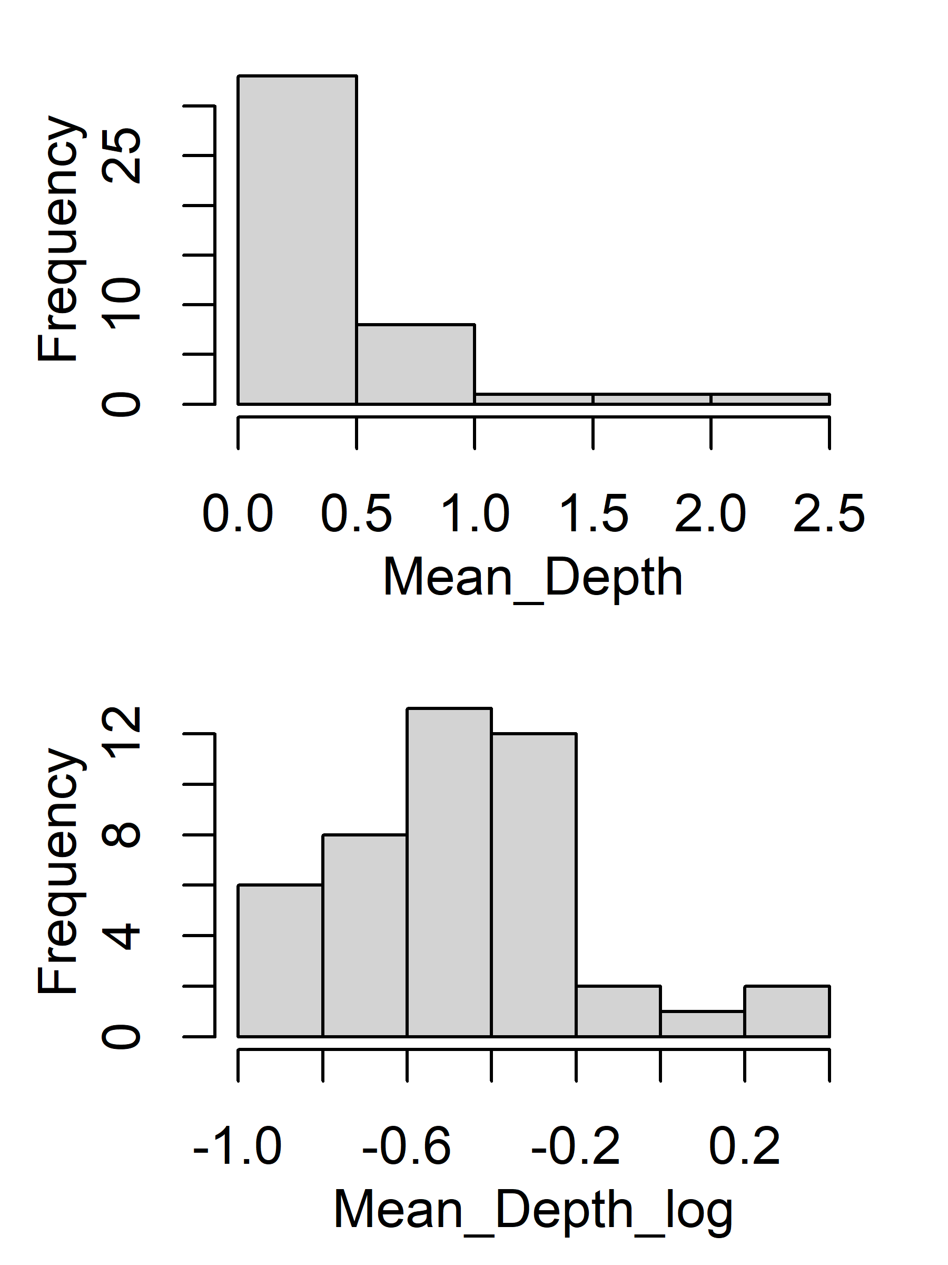
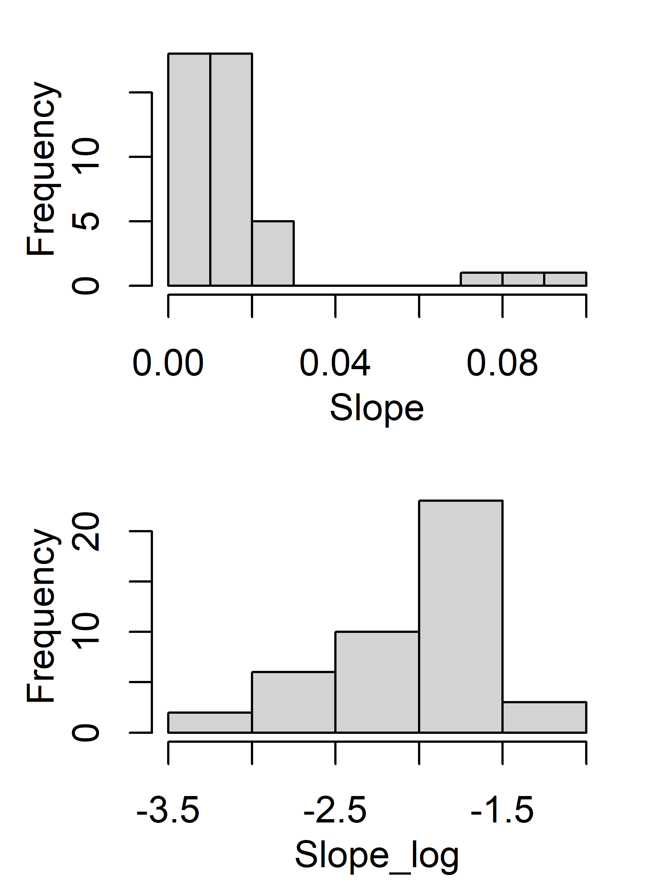
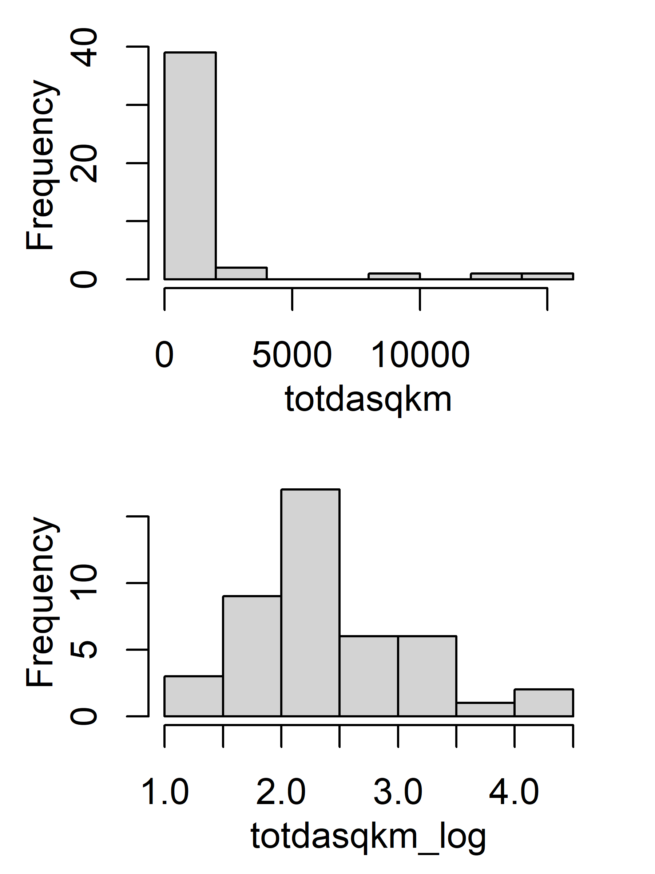
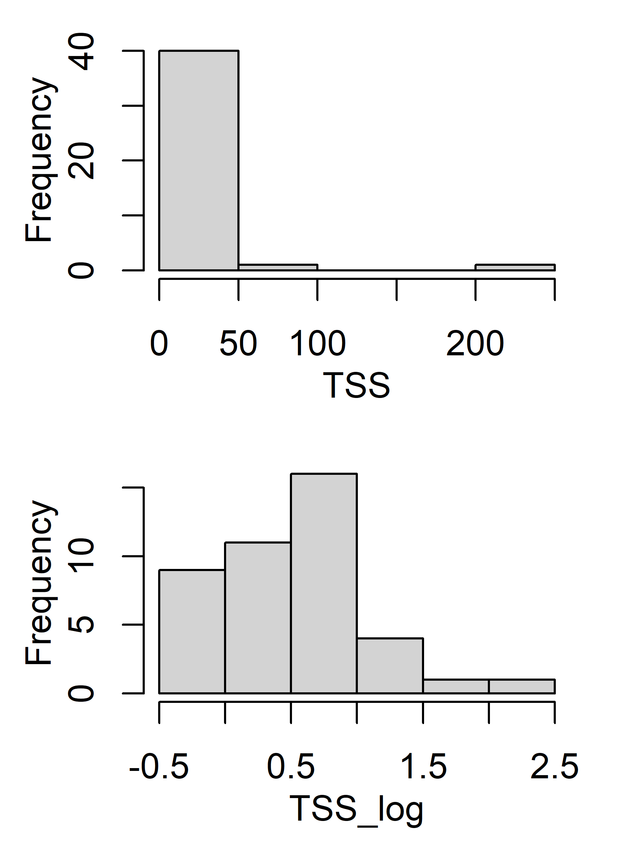
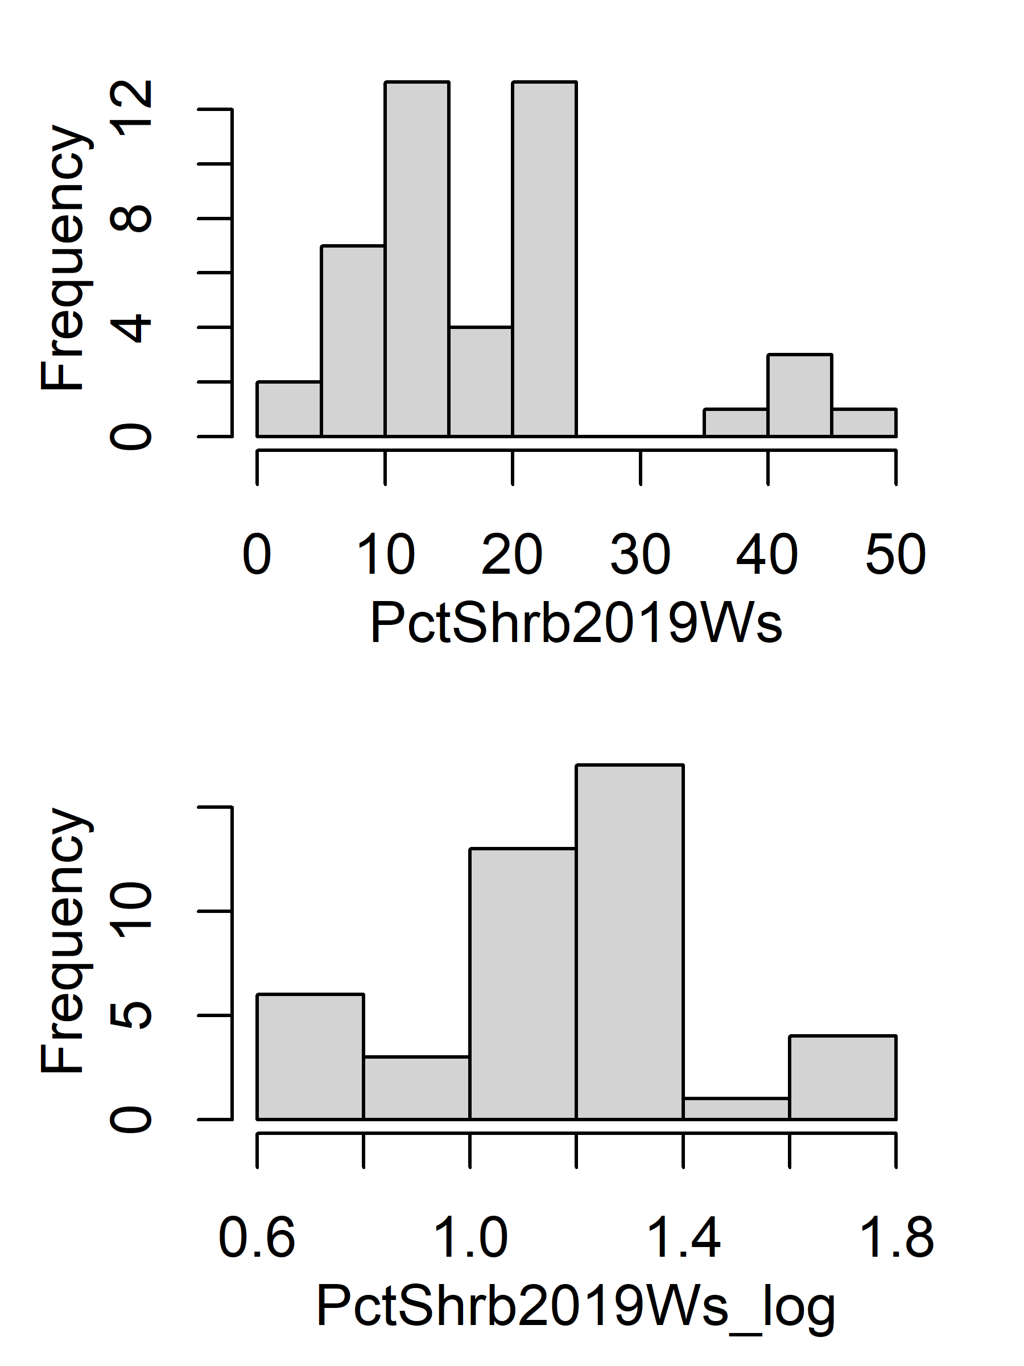
Histogram (original vs log)

Slide 3
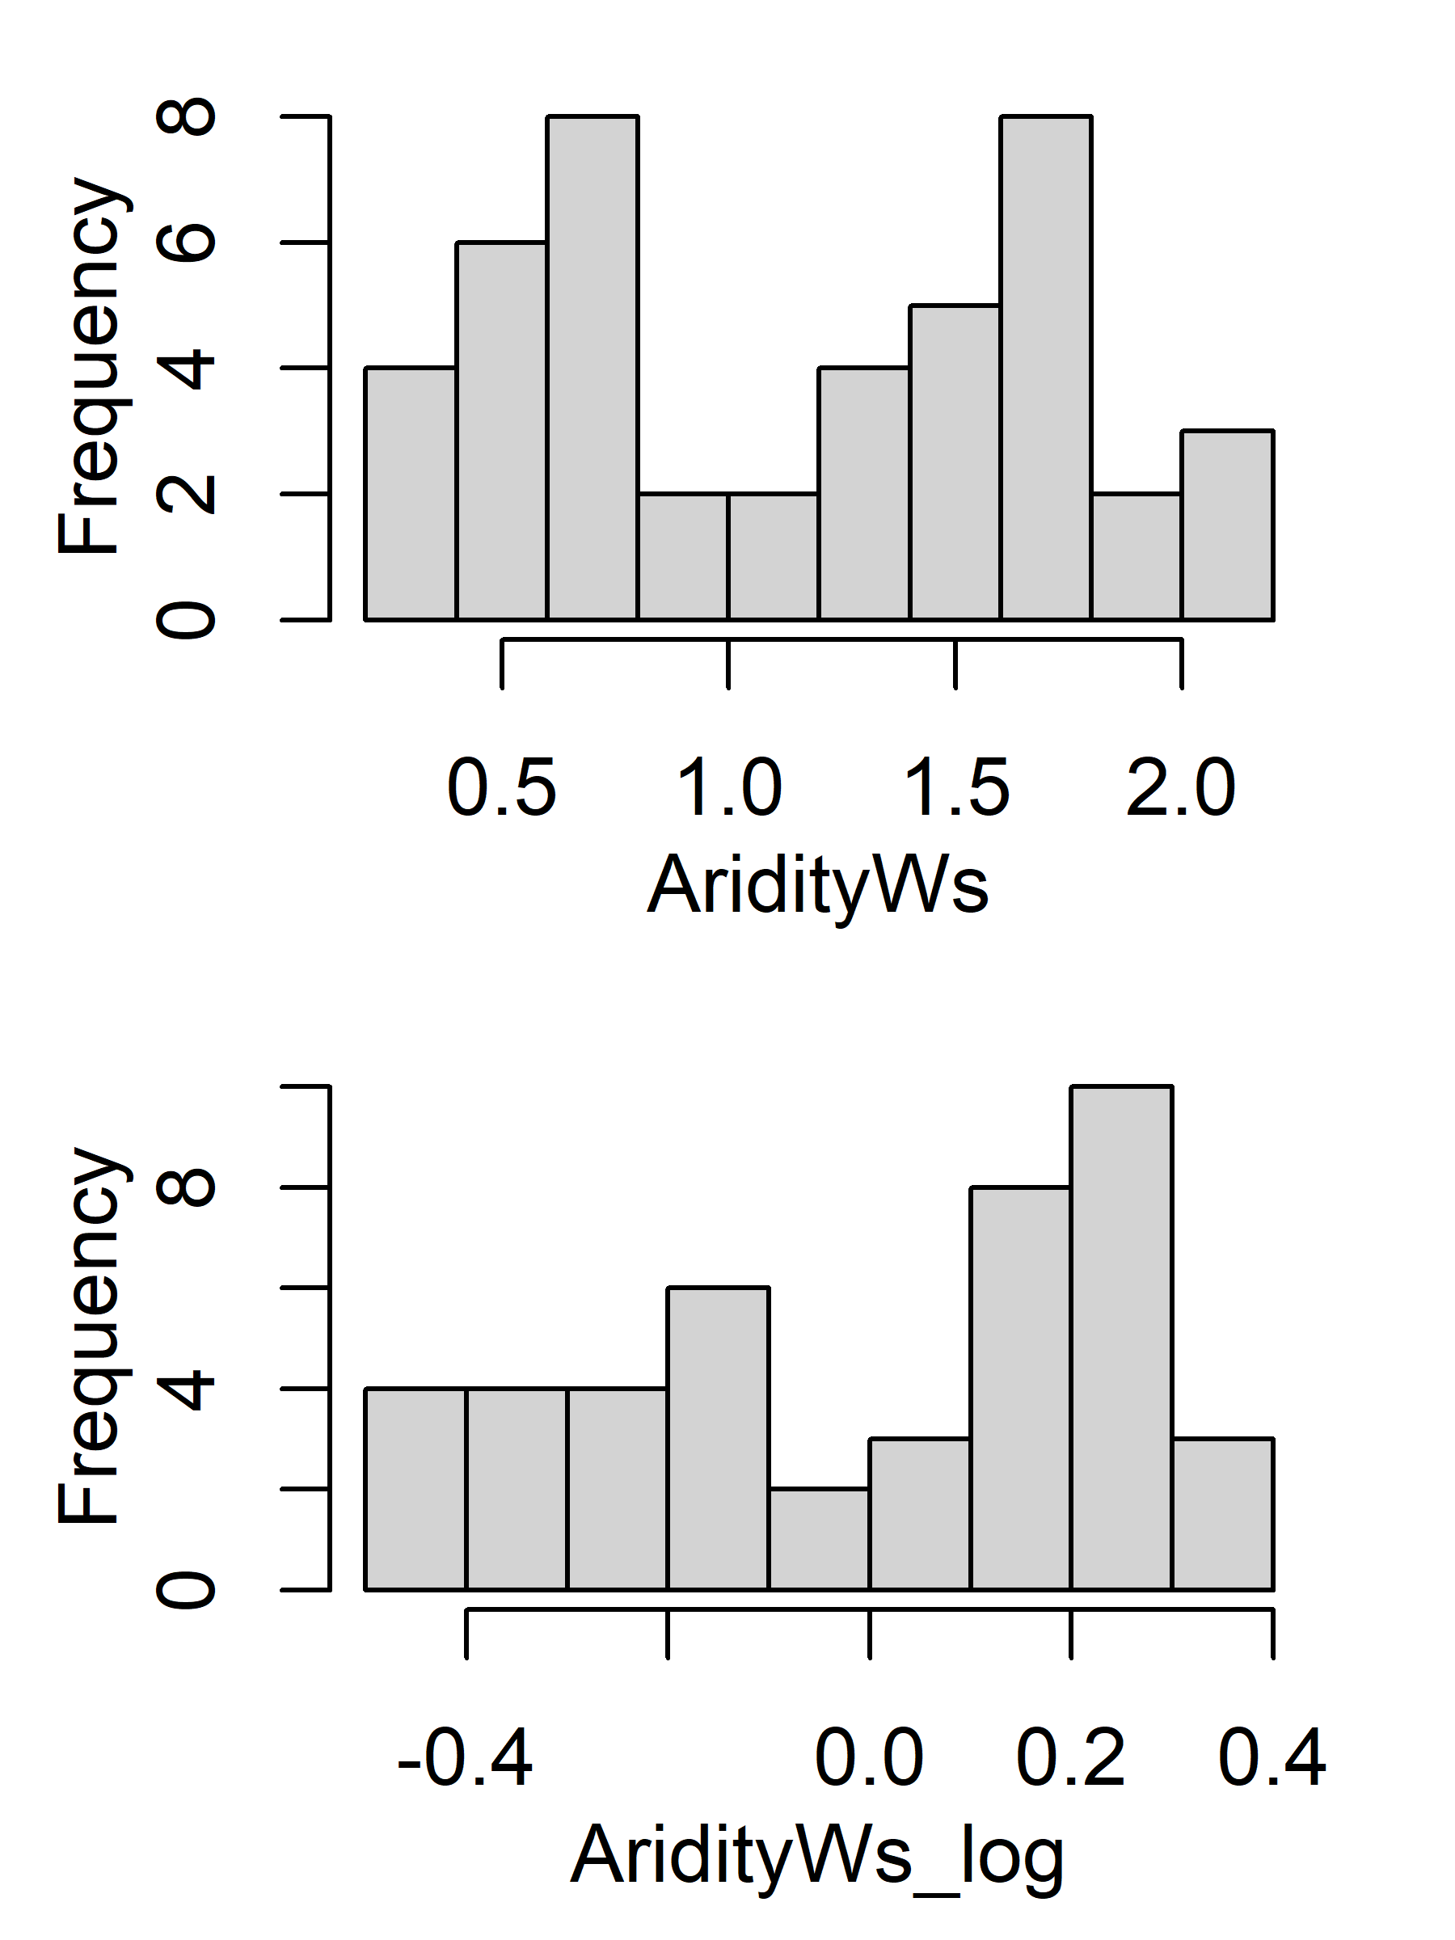
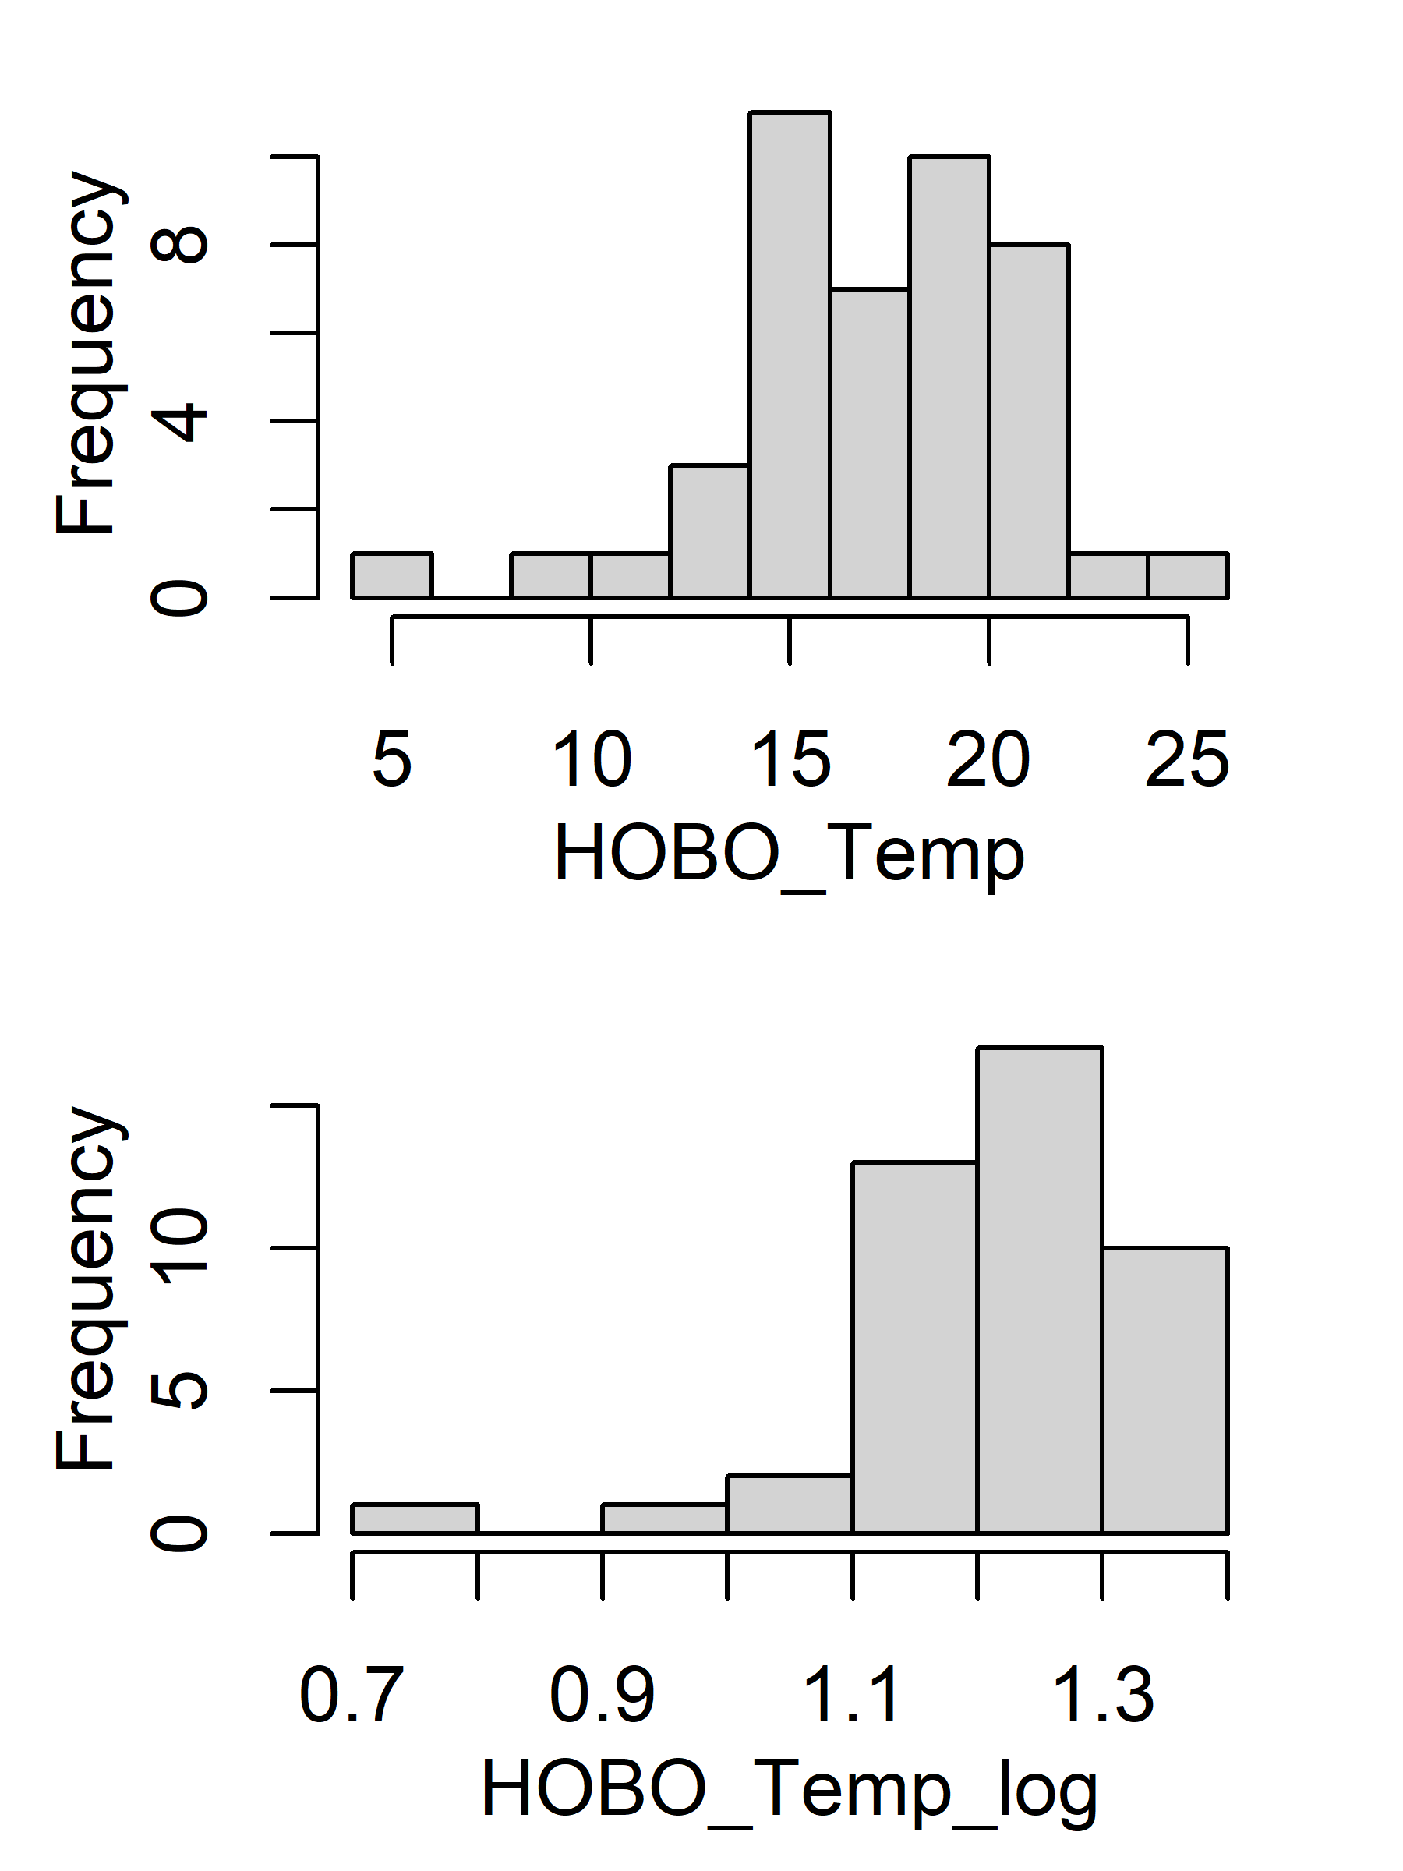
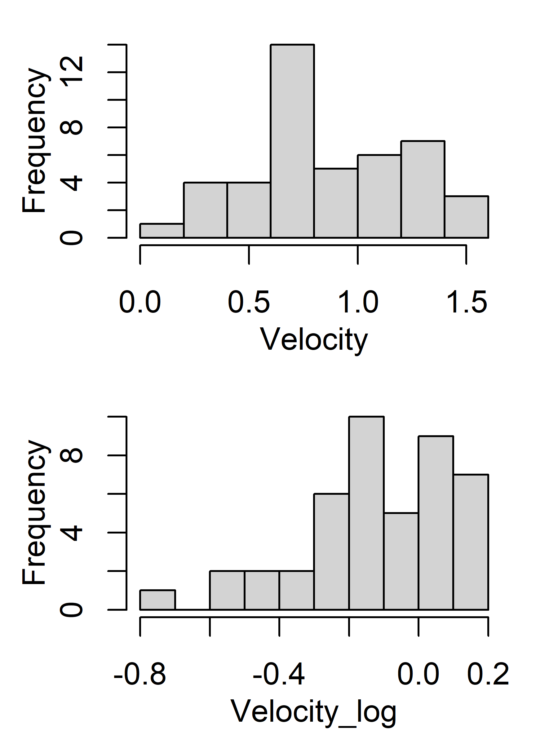
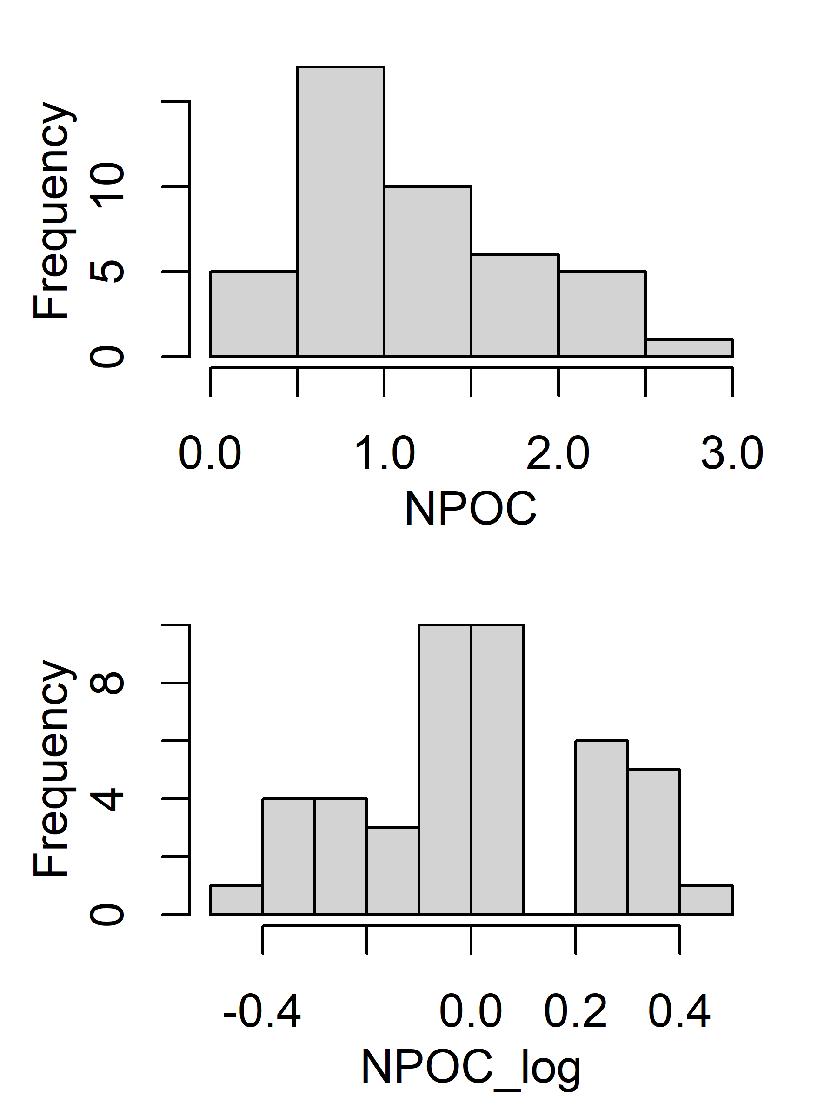
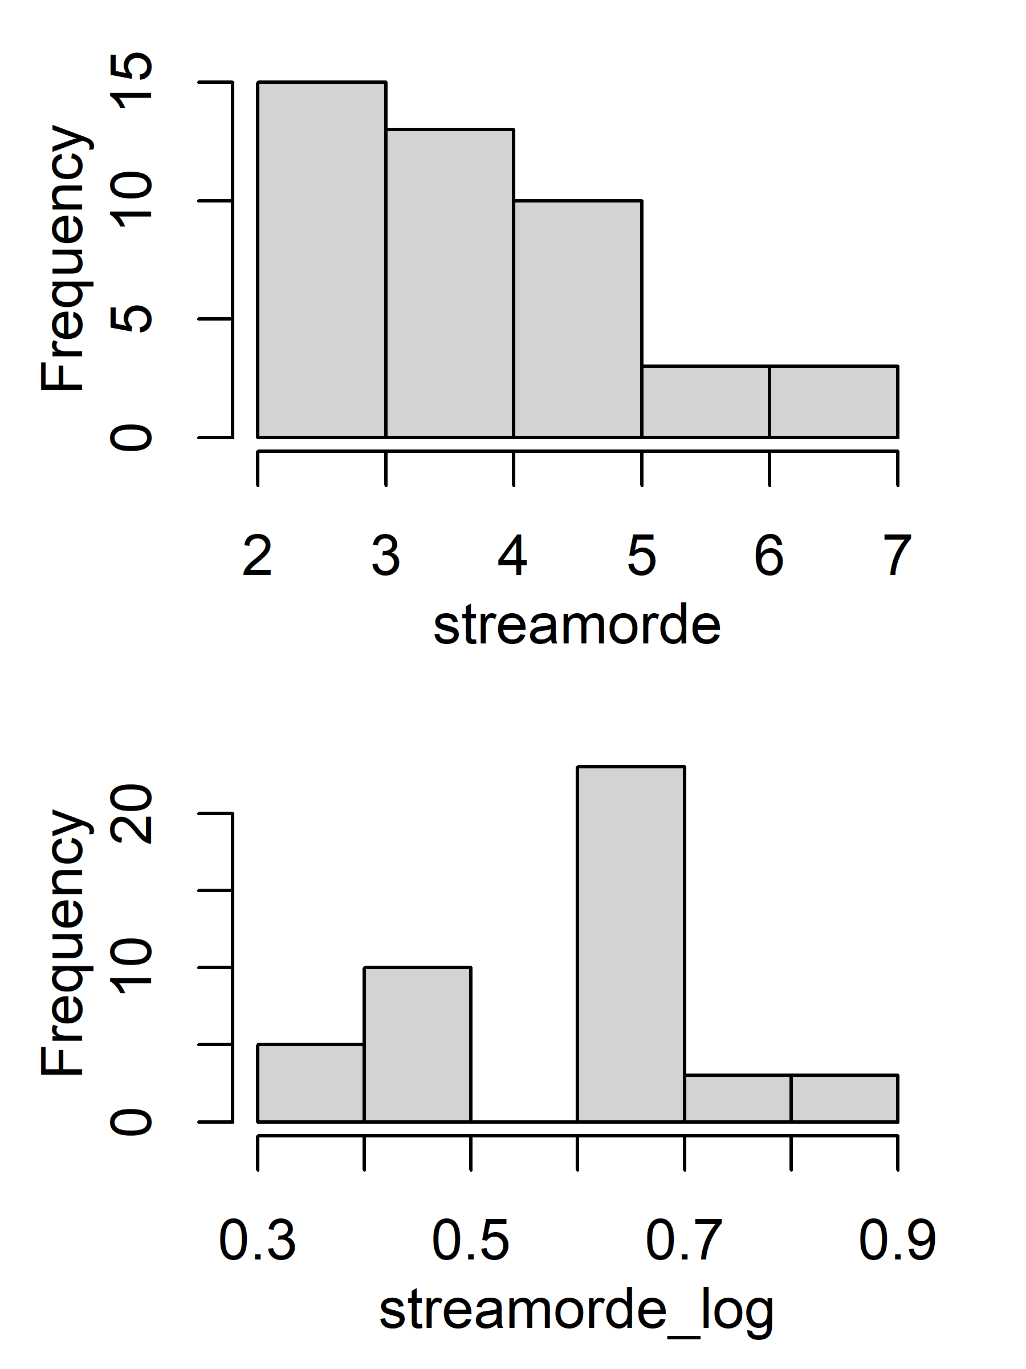
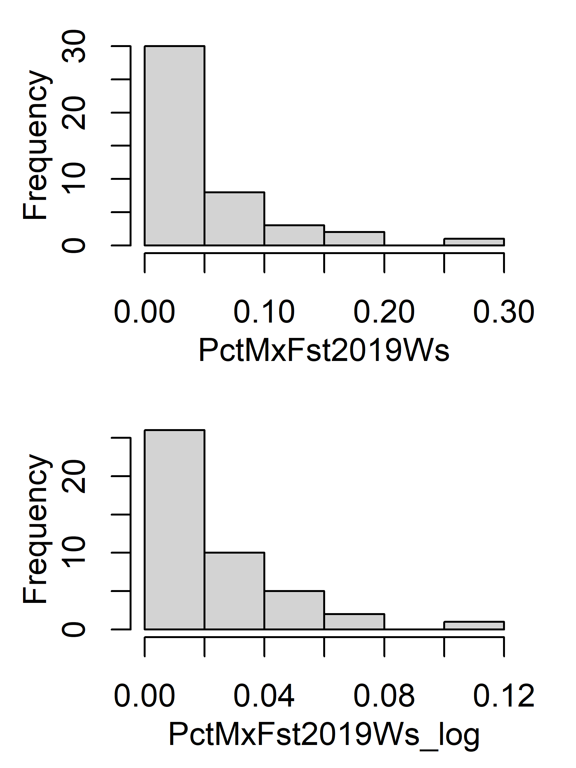
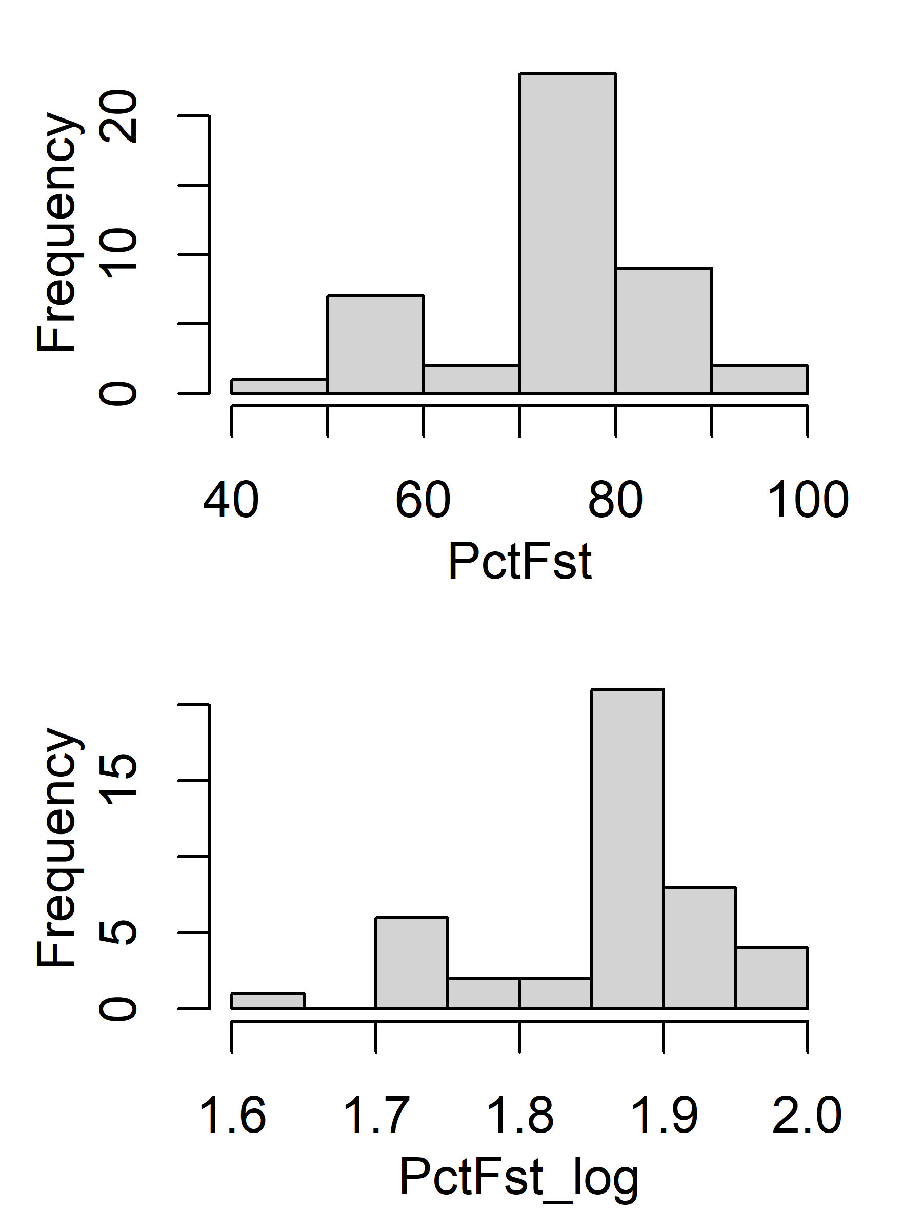
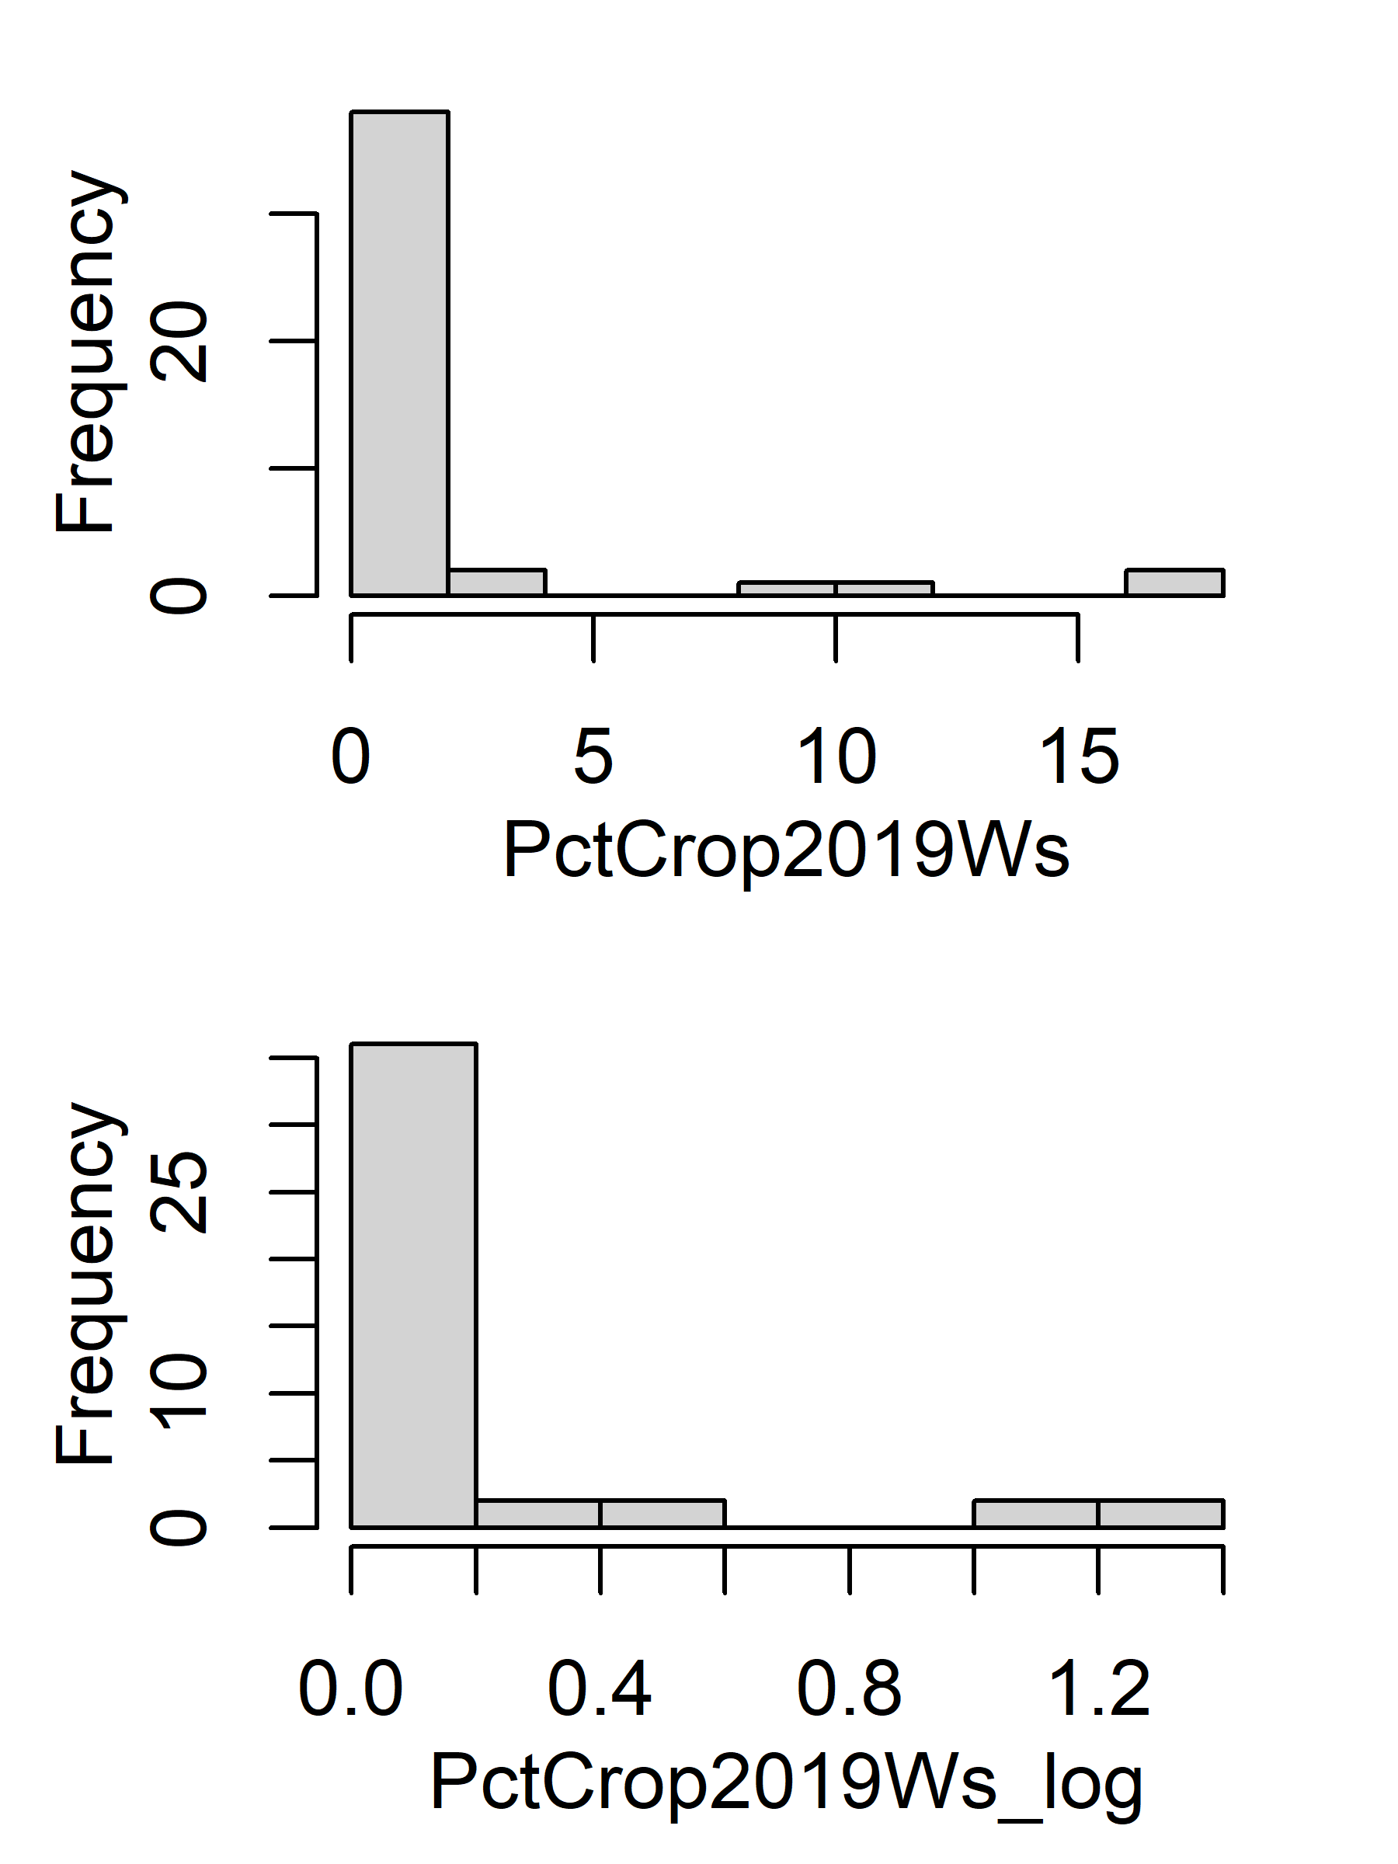
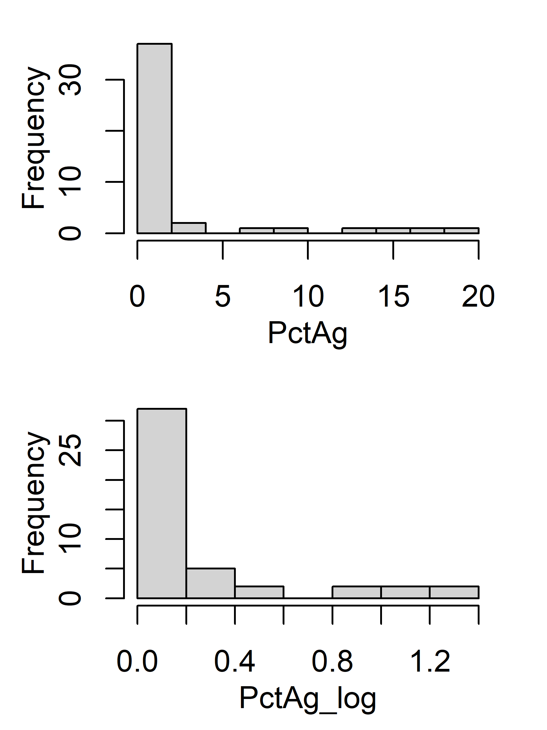
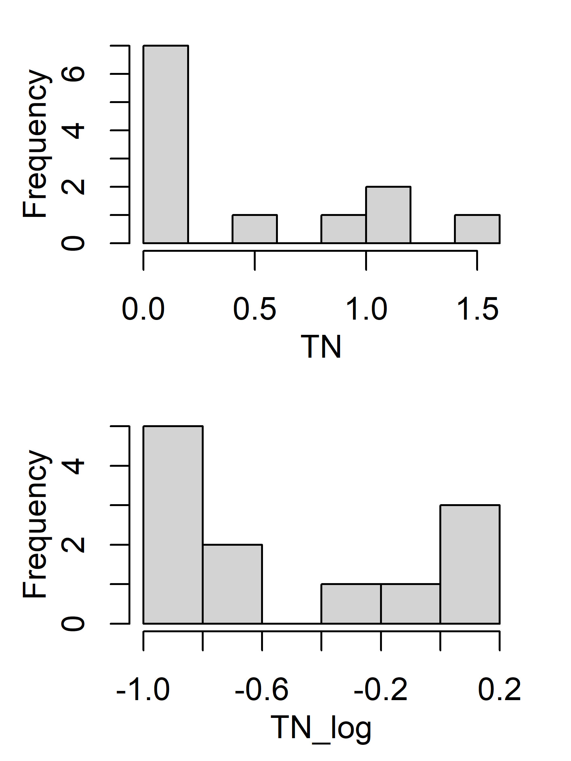
Histogram (original vs log)
#%Forest(PctFst) = %Coniferous+%Evergreen + %Mix
%Ag(PctAg) = %Crop + %Pasture/Hay;

Slide 4
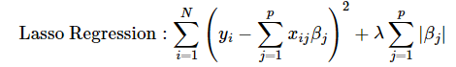
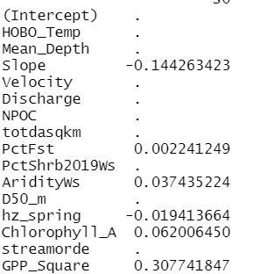
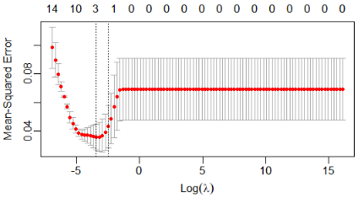
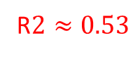
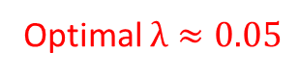
Lasso regression
Log transform all variables(inputs and target variable)
Exclude PctAg(%Crop + %Pasture/Hay) and TN due to skewed distribution after log transformation
Only 40 sites left after removing positive ERsed and NA in variables
Optimal $λ≈0.05$
R$2≈0.53$

Slide 5
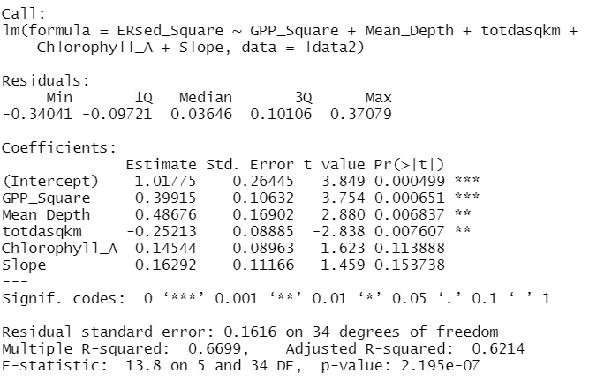
MLR forward/backward selection
Log transform all variables(inputs and target variable)
Exclude PctAg(%Crop + %Pasture/Hay) and TN due to skewed distribution after log transformation
Only 40 sites left after removing positive ERsed and NA in variables
Best model for both forward/backward selection: log(ERsed)~ log(GPP_Square) + log(Mean_Depth) + log(totdasqkm) + log(Chlorophyll_A) + log(Slope)

Slide 6
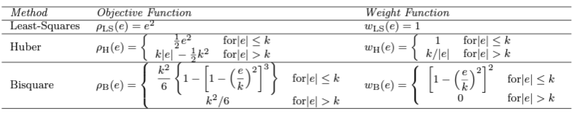
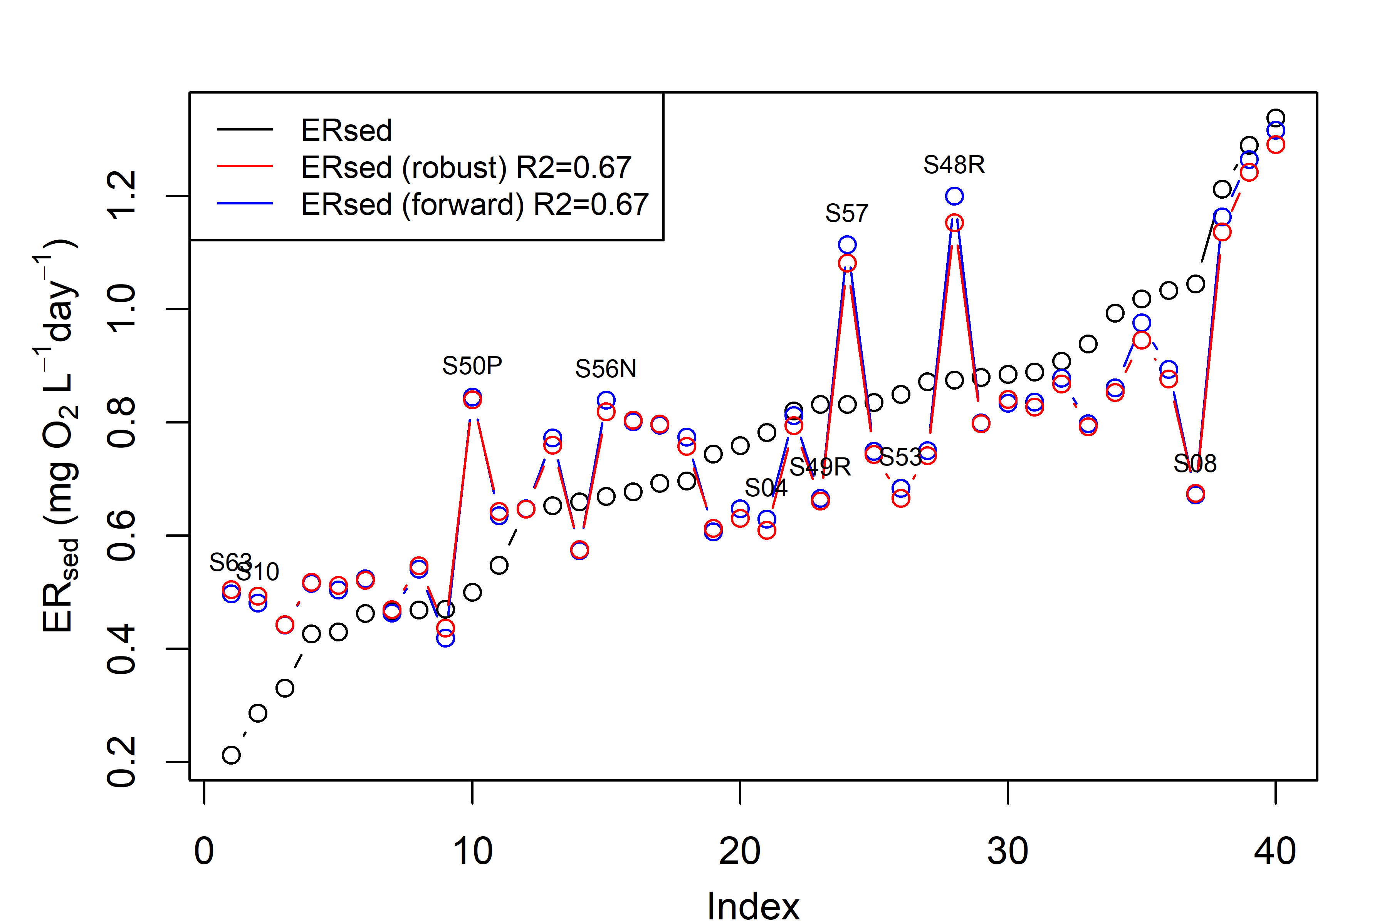
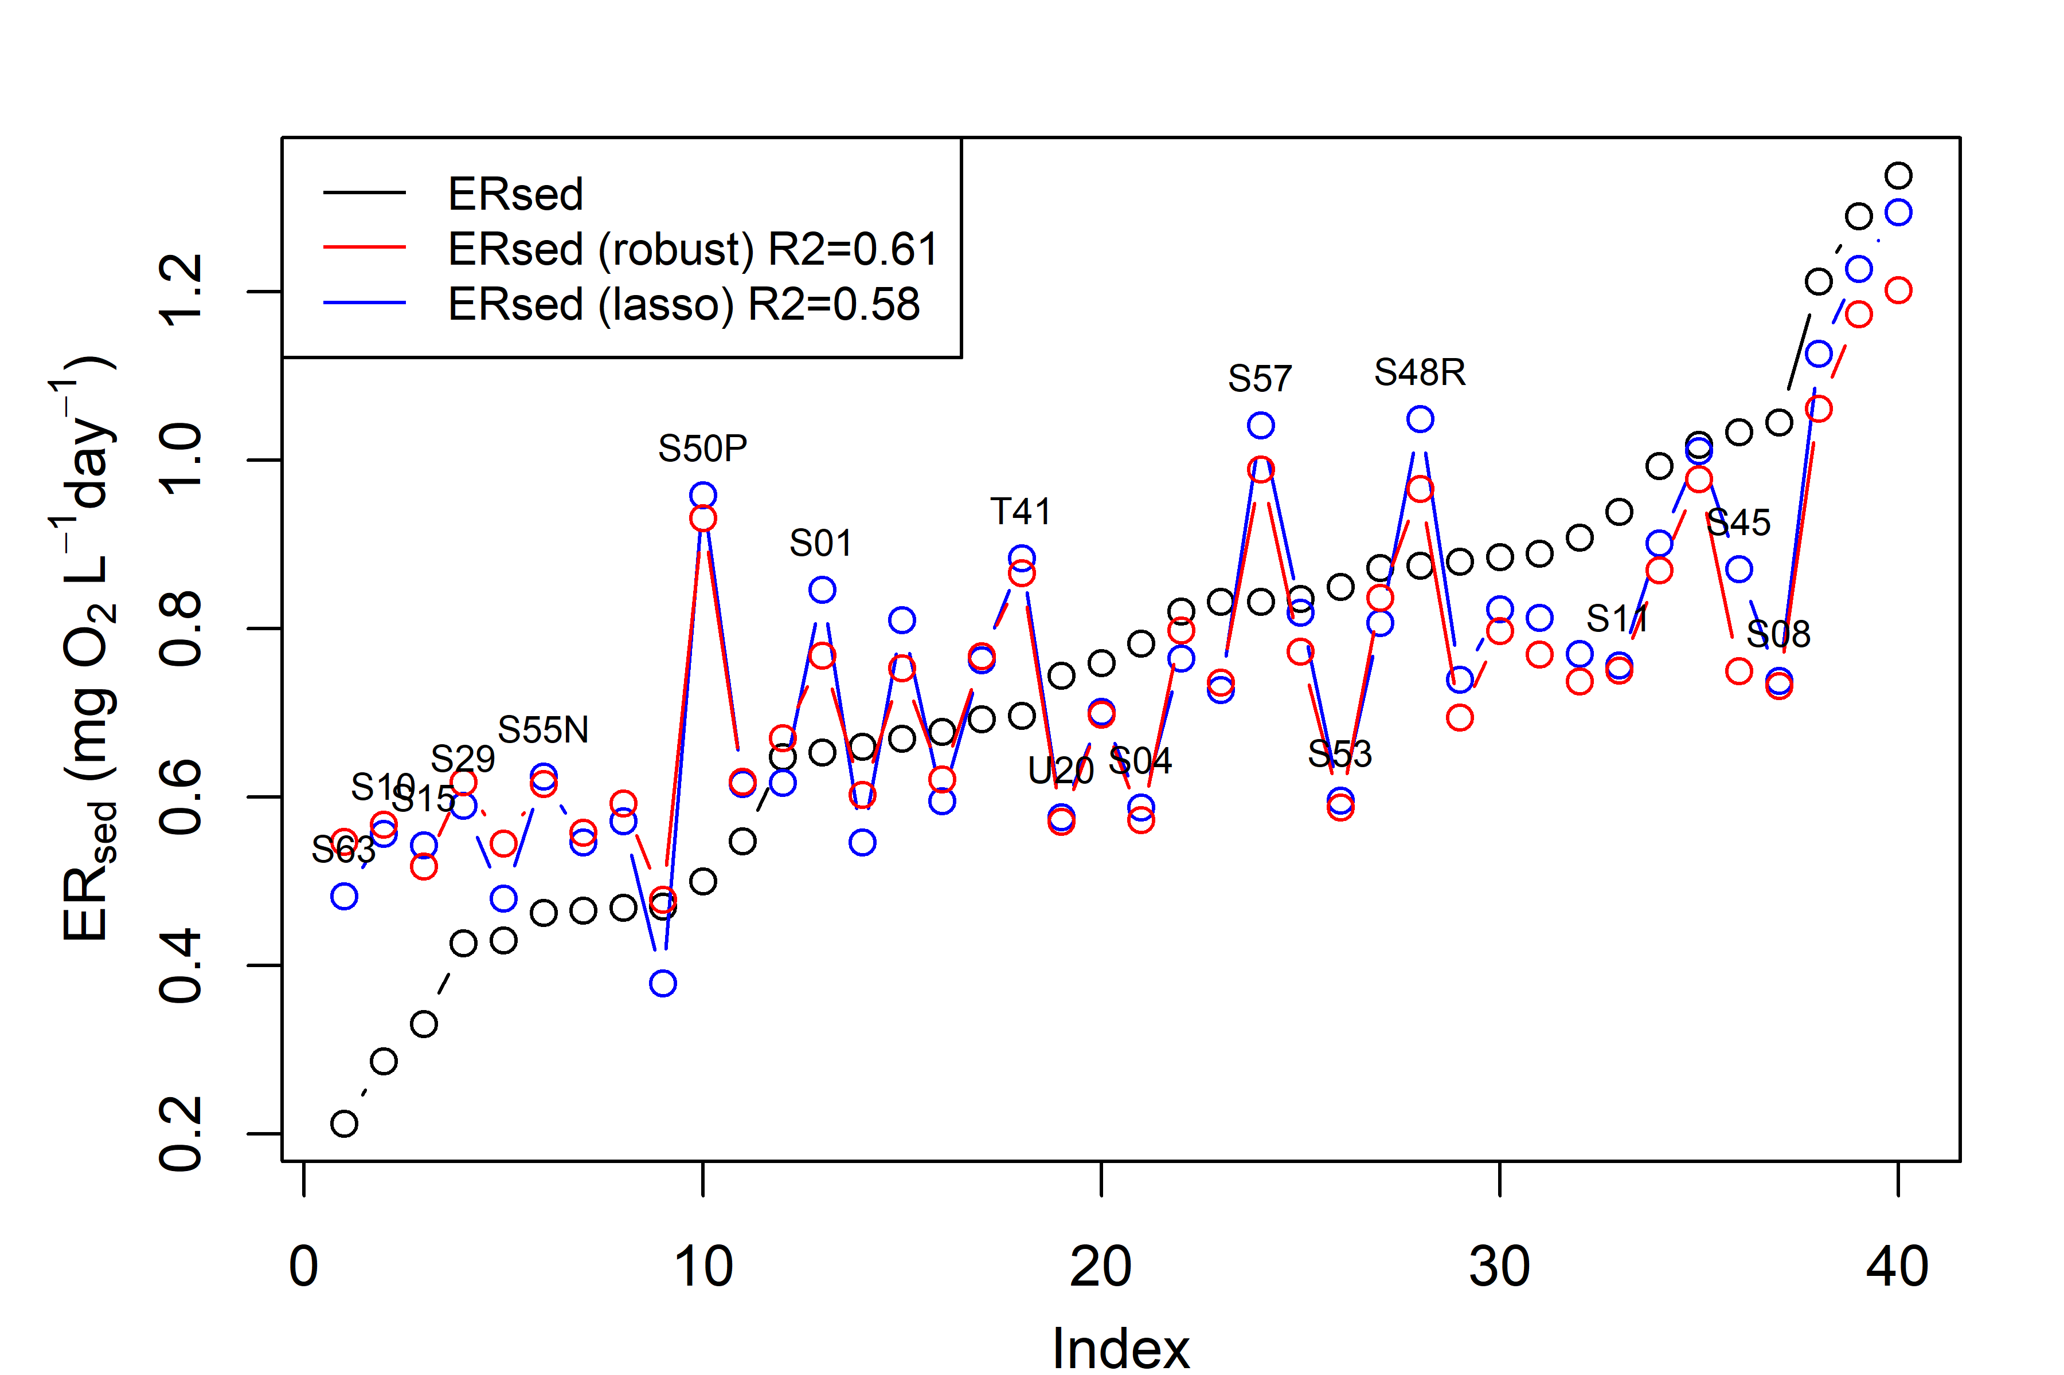
Robust regression (M-estimation)
Log transform all variables(inputs and target variable)
Exclude PctAg(%Crop + %Pasture/Hay) and TN due to skewed distribution after log transformation
Only 40 sites left after removing positive ERsed and NA in variables
M-estimation: a general method of robust regression, can be regarded as a generalization of maximum-likelihood estimation.
Residual:
$$MLR\left(forward\right):{ER}_{sed}\sim 0.4∗GPP_{Square}−0.16∗Slope−0.25∗totdasqkm+0.49∗Mean_{Depth}+0.15∗Chlorophyll_A$$
$$lasso:{ER}_{sed}\sim 0.31∗GPP_{Square}−0.14∗Slope−0.02∗hz_{spring}+0.06∗Chlorophyll_{A}$$
$$+0.002∗PctFst+0.04∗AridityWs$$
$$robust: {ER}_{sed}\sim 0.44∗GPP_{Square}−0.14∗Slope−0.25∗totdasqkm+0.49∗Mean_{Depth}+0.16∗Chlorophyll_A$$
robust$:{ER}_{sed}\sim 0.36∗GPP_{Square}−0.15∗Slope−0.04∗hz_{spring}+0.13∗Chlorophyll_{A}$
$+0.001∗PctFst+0.11∗AridityWs$

